Slide 1
STM32F401RE
Visteon Academy

Slide 2
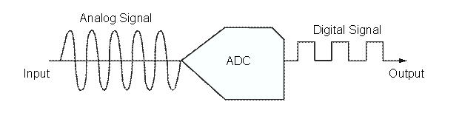
What is ADC?
An ADC (Analog-to-Digital Converter) samples an analog waveform at uniform time intervals and assigns a digital value to each sample. The digital value appears on the converter’s output in a binary coded format.

Slide 3
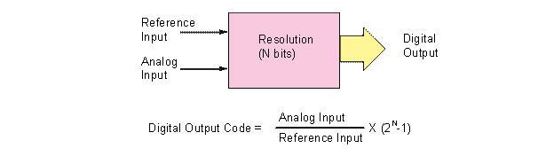
What is ADC?
The value is obtained by dividing the sampled analog input voltage by the reference voltage and them multiplying by the number of digital codes. The resolution of converter is set by the number of binary bits in the output code.

Slide 4
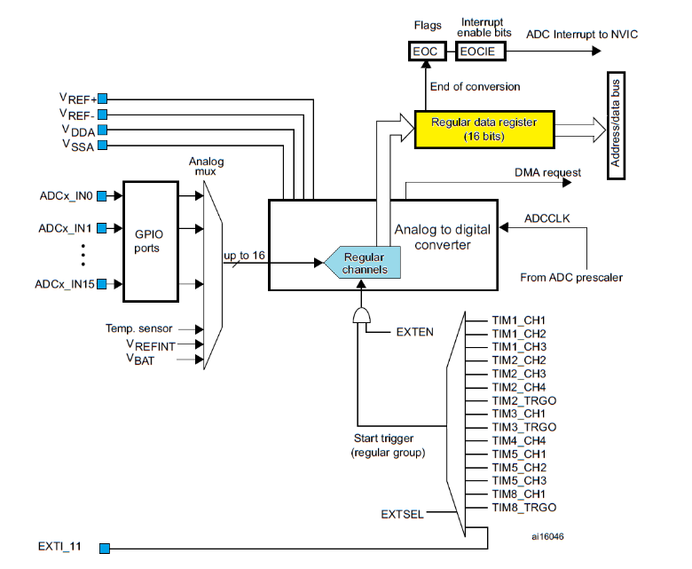
ADC in STM32F4

Slide 5
Configuration
Configure pins that will be used to input analog signals. They must be designated as analog pins, there must be no terminating resistors.
Enable clock for ADCs used .
Configure the use of regular channels for every ADC individually using function “ADC_Init()” and the related data structure . Connect ADCs with input signals.
Enable ADC(s)

Slide 6
ADC Channels
 | Pin | Channel
ADC1/2/3 | PA0 | 0
 | PA1 | 1
 | PA2 | 2
 | PA3 | 3
 | PC0 | 10
 | PC1 | 11
 | PC2 | 12
 | PC3 | 13
ADC1/2 | PA4 | 4
 | PA5 | 5
 | PA6 | 6
 | PA7 | 7
 | PB0 | 8
 | PB1 | 9
 | PC4 | 14
 | PC5 | 15

